Slide 1




MBC 638: Data Analysis & Decision Making
Anna Chernobai
Lecture 05 – PART 2:
Simple and multiple regressions (Chapter 10)

Slide 2
Today: Regression analysis
0. Recall (Lecture 04): Association among numerical variables
Scatterplots
Covariance and Correlation
Simple linear regression
Multiple linear regression Chapter 10 (10.5)
Linear regressions with dummy variables and interaction variables
Nonlinear modeling possibilities

Slide 3
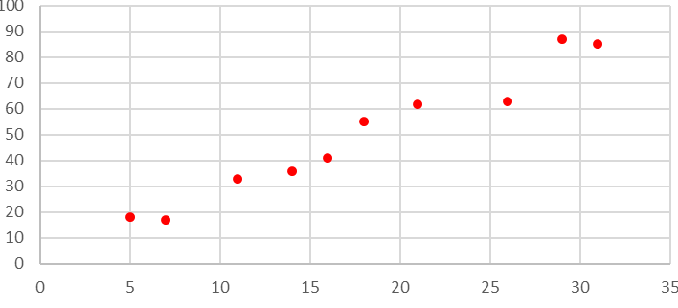
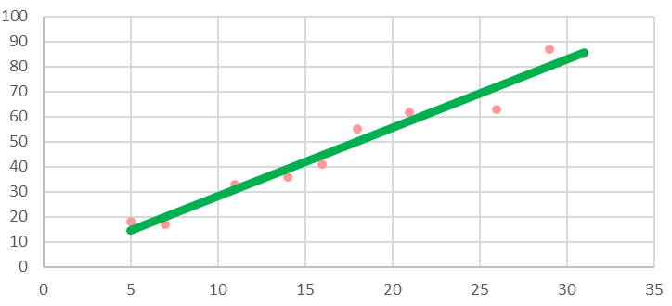
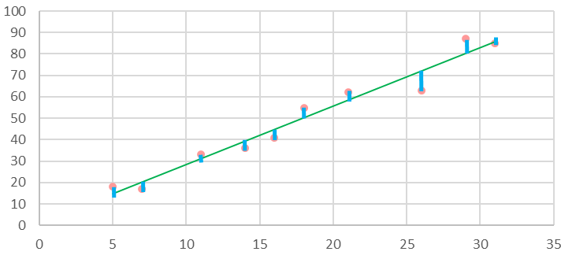
Review: Simple linear regression
actual values of Y = predicted values of Y + errors
Predicted values of Y depend on X and follow a straight line.
Regression equation:
Only one explanatory variable
ŷ = b₀ + b₁ · x
error
Predicted value of Y intercept slope explanatory variable

Slide 4
2. Multiple linear regression
Multiple regression equation:
Ŷ = b₀ + b₁* X₁ + b₂* X₂ + b₃* X₃ + …
A fitted regression equation may look something like this:
Ŷ = 0.5 + 1.2* X₁ – 3.4 * X₂ + 0.7* X₃
Only one explanatory variable
Three explanatory variables
Only one explanatory variable

Slide 5
2. Multiple linear regression
Example
Housing prices. See Excel file Housing Data 148.xlsx
Y = Selling prices
X₁ = Square footage
X₂ = Number of bedrooms
X₃ = Number of baths

Slide 6
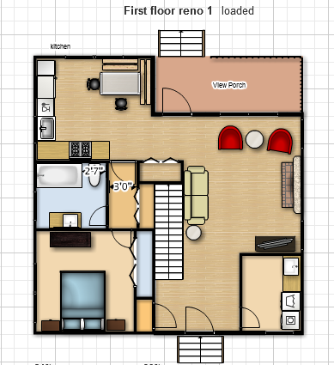
2. Multiple linear regression
Square footage
r = 0.749
Simple linear regression:
ŷ = 50527 + 46.991x R² = 0.5618

Slide 7

2. Multiple linear regression
#Bedrooms
r = 0.587
Simple linear regression:
ŷ = 103183 + 9813.8x R² = 0.3451

Slide 8

2. Multiple linear regression
#Bathrooms
r = 0.446
Simple linear regression:
ŷ = 117364 + 5127.9x R² = 0.1989

Slide 9
2. Multiple linear regression
Square footage #Bedrooms #Bathrooms
r = 0.749 r = 0.587 r = 0.446
Simple regression: Simple regression: Simple regression:
ŷ = 50527 + 46.991x ŷ = 103183 + 9813.8x ŷ = 117364 + 5127.9x R² = 0.5618 R² = 0.3451 R² = 0.1989

Slide 10
2. Multiple linear regression
Let us now run a single regression (= a multiple regression) with all 3 predictors in the same model…

Slide 11
2. Multiple linear regression
Multiple regression:

Slide 12
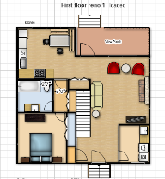


2. Multiple linear regression
This output means that the regression equation is:
Predicted selling price ($) = 50,024
 47.6 * Square Feet
― 136.5 * Num Bedrooms
― 75.8 * Num Bathrooms

Slide 13
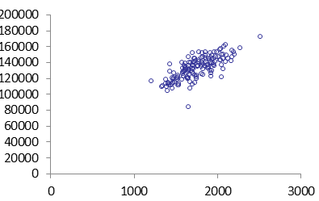
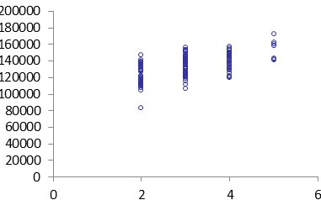
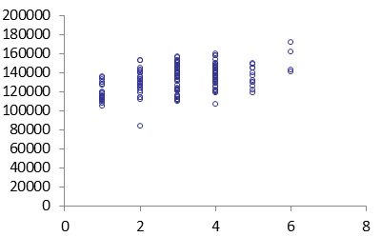
2. Multiple linear regression
Wait a second!!!
Predicted selling price ($) = 50,024
 47.6 * Square Feet
― 136.5 * Num Bedrooms
― 75.8 * Num Bathrooms
Why are these coefficients negative?
Question: Why are these coefficients negative??

Slide 14
2. Multiple linear regression
This output means that the regression equation is:
Predicted selling price ($) = 50,024
 47.6 * Square Feet
― 136.5 * Num Bedrooms
― 75.8 * Num Bathrooms
ANSWER: Because we change #BR while holding SqFt and #BA constant
ANSWER: Because we change #BA while holding SqFt and #BR constant

Slide 15
2. Multiple linear regression
For multiple regressions, use adjusted R-squared

Slide 16
2. Multiple linear regression
How good is the overall linear model?
How well can we explain selling price by looking at square footage, # BR, and # baths?
How much of variability in selling price is explained by square footage, # BR, and # baths?
R-squared adjusted
When we add more explanatory variables into our model, R-squared always goes up.
However, R-squared adjusted can go up or down:
Up, because we improve the explanatory power of the model by adding more predictors.
Down, because it penalizes us for having too many (unnecessary) predictors.
Which of the two effects dominates when you add a new predictor depends on how good the predictor is.
Stepwise regression approach: Start with one (most important) predictor, then add a 2nd predictor at a time and see what happens to R-squared adjusted. If it drops, don’t add this predictor. If it goes up, keep it. Then try adding a 3rd predictor, 4th, and so on…

